Slide 1









Thanks to our Event Sponsors!

Slide 2











Thanks to our Raffle Donors!

Slide 3











Thanks to our Raffle Donors!

Slide 4



Thanks to our Team Sponsors!

Slide 5
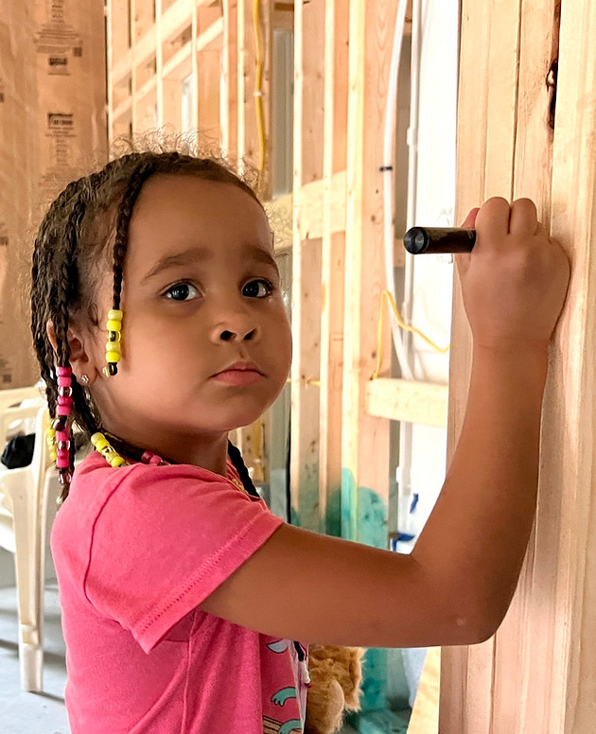

Proceeds Benefit …
GIVE

Slide 6
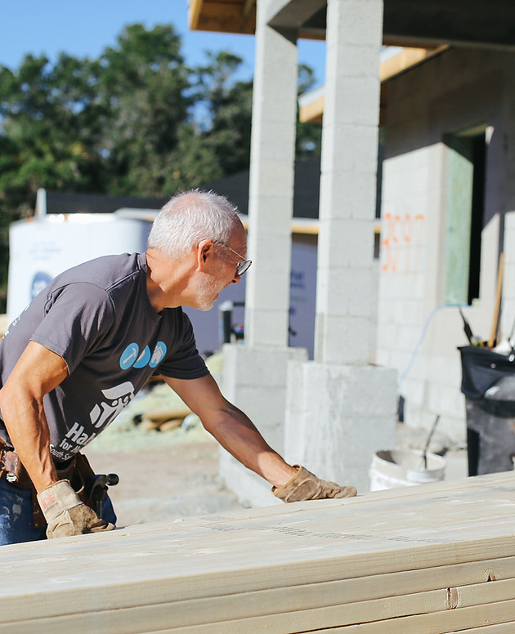
Proceeds Benefit …
Volunteer

Slide 7
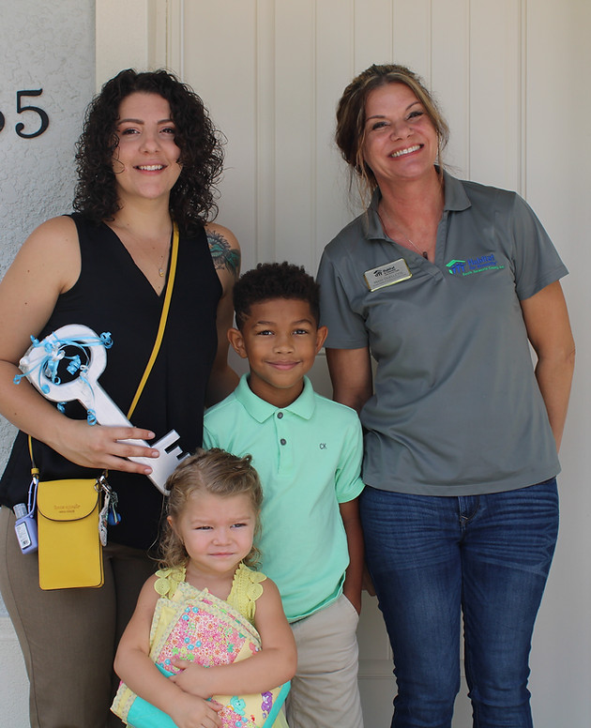
Proceeds Benefit …
Home Ownership

Slide 8
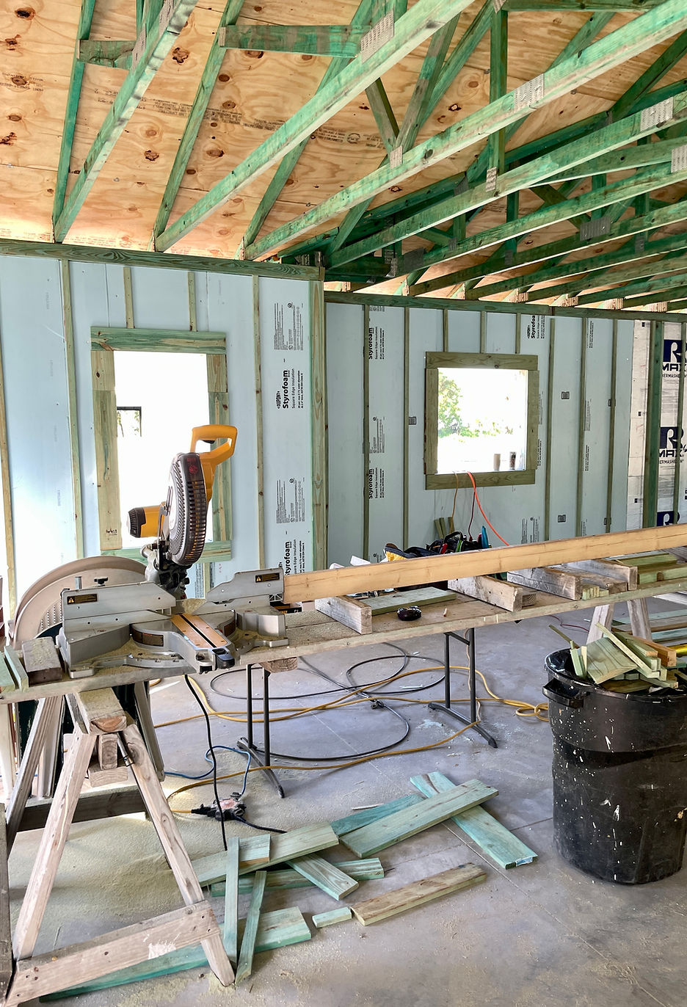
Proceeds Benefit …
167 Homes Built Since 1992

Slide 9
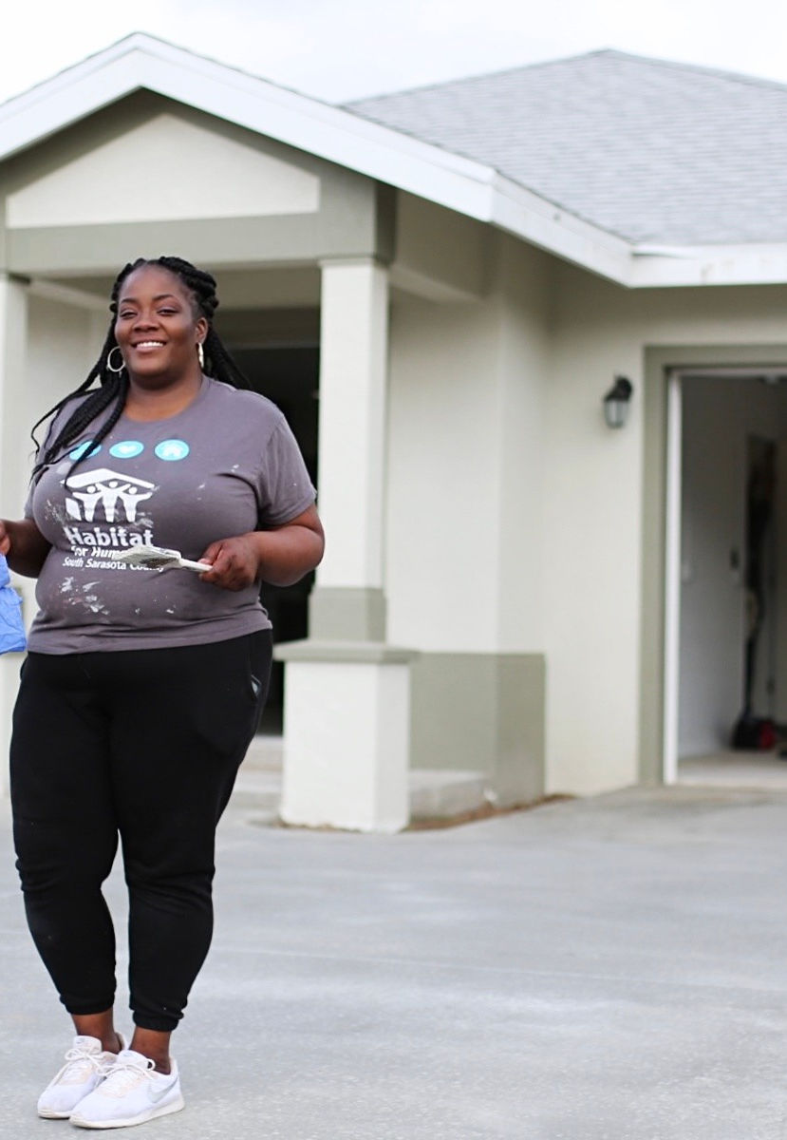
Proceeds Benefit …
20 Local Families Purchased Homes
from FY 2019-2023

Slide 10
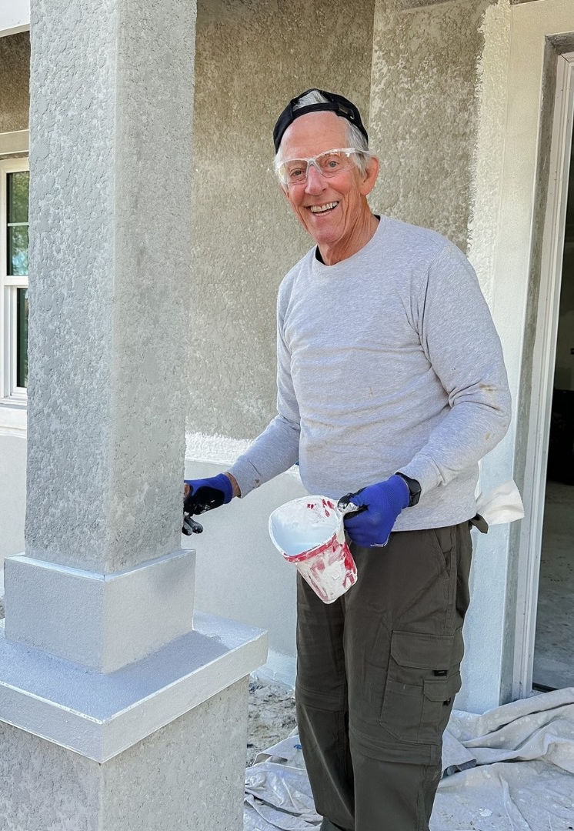
Proceeds Benefit …
152 Volunteers
Completed 9,734
Hours in 2022

Slide 11
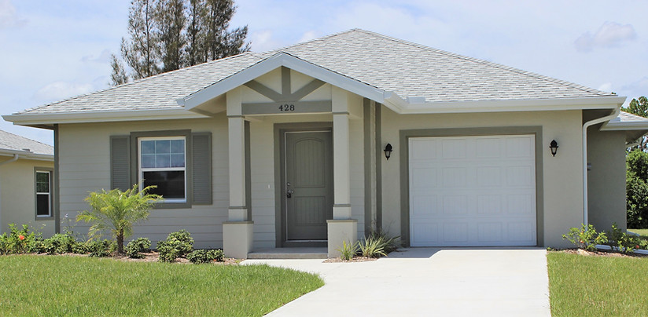
Proceeds Benefit …
Habitat South Sarasota homes are ENERGY STAR certified. Building “green”!!

Slide 12

Proceeds Benefit …
Educational Resources
Homeownership Classes
“Habitat 101”

Slide 13


Proceeds Benefit …

